Slide 1
Closing Remarks, Survey and Quiz for Certification
ACE-Security
ACE Solutions Architecture Team
Notes:
This course is built by Shahzad Ali with the help from Joe and Rizwan from ACE Team.
For comments, please reach out to shahzad@aviatrix.com for comments or improvements.

Slide 2
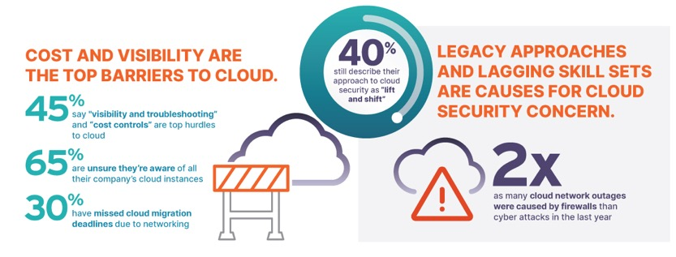
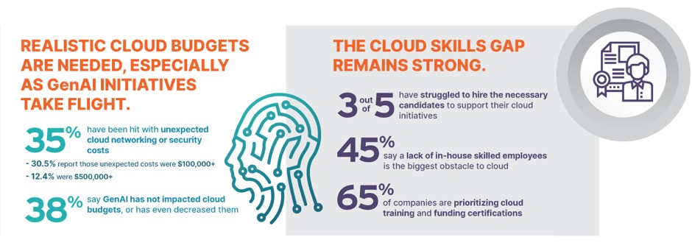
2024 Secure Cloud Networking Field Report
Critical insights from over 400 global practitioners

Slide 3
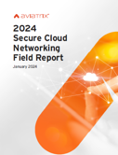


Download the 2024 Secure Cloud Networking Field Report
Critical insights from over 400 global cloud, networking, and security practitioners
Network with Peers in The Cloud Network Community
Join the community created for cloud networking experts to connect, collaborate, and have fun
Get ACE Certified
The industry’s leading multicloud networking training and certification program
Join a Community Office Hours
Storytelling, demos, collaboration, ask the expert sessions, and more

Slide 4
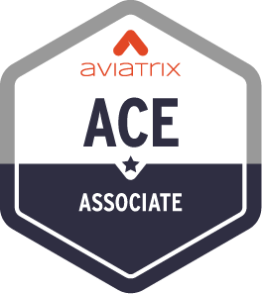
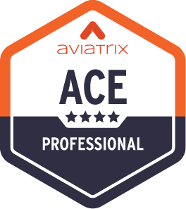

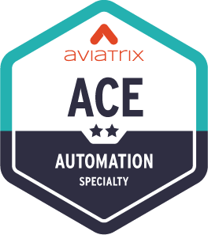
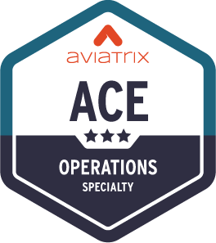
ACE Multicloud Networking Certification Program
Standard Learning Path
The Aviatrix Certified Engineer (ACE) Program is the industry’s first and only multicloud networking certification.
Its comprehensive training and specialized courses provide a deep understanding of building, operating, automating, scaling, and securing multicloud networks across AWS, Azure, Google Cloud, Oracle Cloud Infrastructure, and more.
The ACE Program ensures participants are equipped with best practices that span all major cloud providers, as well as the Aviatrix Cloud Networking Platform.
6 Hours
Learn CSP networking basics and review Aviatrix features
3 Days
Deploy proven design patterns for a multicloud network architecture
Weeks
Design a highly available, scalable, and secure multicloud architecture
Optional Specialty Trainings
4 Hours
Use IaC tools to build, enhance, and secure infrastructure
8 Hours
Troubleshoot real-world Day 2 cloud issues​

Slide 5
ACE-Security Certification Requirements
Attend the entire course
Complete the survey
Complete and pass the quiz

Slide 6
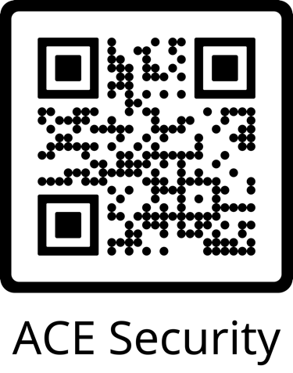
Complete the ACE- Security Lab-Based Quiz
The same survey link is also embedded inside the Quiz.
https://pages.aviatrix.com/ace-security-survey.html

Slide 7
Complete and Pass the Quiz
Quiz URL: https://ace.aviatrix.com/ace-multicloud-network-security-quiz
To complete the quiz, you must use the Aviatrix ACE-Security Pod
Read-only access is provided
Take your time
You have 24 hours to complete the quiz
After 24 hours lab pod will be shutdown
LAB POD Read Only User: student
LAB POD Read Only User Password: LAB POD URL
LAB POD URL: https://docs.aviatrixlab.com/ace-security/
Notes:
8 of 12 Correct (66%) is pass
Password: 210Hf67x##wFkH

Slide 8
Thank You!
For attending and completing the Survey

Slide 9
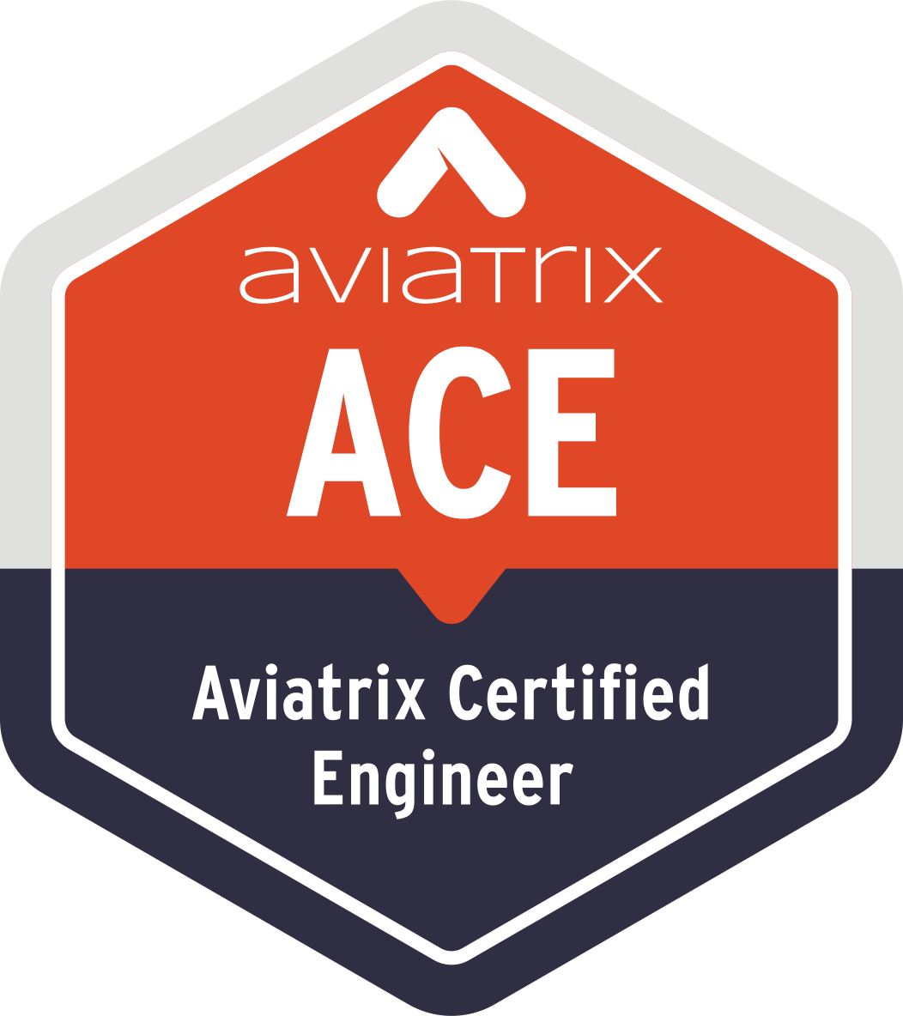

Aviatrix Certified Engineer (ACE)
COMMUNITY
https://aviatrix.com/ACE
https://community.aviatrix.com

Slide 10
Course Flow
101 Level What is it?
101 level How does it work?
101 Level Gaps/Limitations
101 Cost Implications

Slide 11
